Slide 1
Topic: Drawing 3D Objects EQ: How Do I Draw 3D Shapes?
Year 7 Mathematics
Mrs Parlevliet

Slide 2
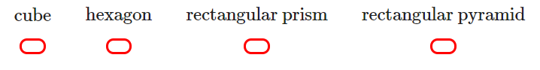
FIVE Questions (LHS)
Topic: Drawing 3D Objects EQ: How do I draw 3D shapes?
Date: XX/XX/2021
What is the perimeter and area of a rectangle with a length of 4m and width of 2.5m?
A triangle has a base of 4m and height of 3.5m. What is its area?
Convert 1.25km to cm.
What is a 3D shape?
A 3D object has 6 faces. Only 2 faces are squares, the other 4 faces are rectangles. The object is a:
Notes:
12m²
10.4m
6700 mm
54m²

Slide 3
24
7
30
Topic: Drawing 3D Shapes
Date: XX/XX/2021
EQ: How do I draw 3D shapes?
How do I draw 3D shapes using isometric paper?
On isometric paper we only draw lines going in one of THREE different directions.
We NEVER draw horizontal lines.
So always remember:
NO HORIZONTAL LINES going from right to left.

Slide 4
24
7
30
Topic: Drawing 3D Shapes
Date: XX/XX/2021
EQ: How do I draw 3D shapes?
Example 1:
Draw this cube on
isometric paper.
Start by drawing
the top.
Next draw the vertical lines.
Now draw these diagonal lines.
Note: We have to draw the solid
like this.

Slide 5
24
7
30
Topic: Drawing 3D Shapes
Date: XX/XX/2021
EQ: How do I draw 3D shapes?
Example 2:
Draw this 3D solid on
isometric paper.
Start by drawing
the top.
The solid is 2 units high, so we will draw the sides.
Now draw these diagonal lines.
Note: We have to draw the solid
like this.
Finally draw these diagonal lines.

Slide 6
24
7
30
Topic: Drawing 3D Shapes
Date: XX/XX/2021
EQ: How do I draw 3D shapes?
Example 3:
Draw this 3D solid on
isometric paper.
Start by drawing
the top.
The solid is 3 units high, so we will draw the sides.
Now draw these diagonal lines.
Note: We have to draw the solid
like this.
Finally draw these diagonal lines.

Slide 7
24
7
30
Topic: Drawing 3D Shapes
Date: XX/XX/2021
EQ: How do I draw 3D shapes?
Example 4:
Draw this 3D solid on
isometric paper.
Start by drawing
the top.
The solid is 3 units high, so we will draw the sides.
Now draw these diagonal lines.
Note: We have to draw the solid
like this.
Then draw these vertical lines.
Now draw these diagonal lines.
Now we can draw the final lines.

Slide 8
Task
Example 5:
Draw this 3D solid on
isometric paper.
Start by drawing
the top.
The solid is 3 units high, so we will draw the sides.
Now draw these diagonal lines.
Note: We have to draw the solid
like this.
Then draw these vertical lines.
Now draw these diagonal lines.
Now we can draw the final lines.

Slide 9
Task
Example 6:
Draw this 3D solid on
isometric paper.
Start by drawing
the top.
Next we will draw these two side lengths.
Now draw these diagonal lines.
Note: We have to draw the solid
like this.
Then draw these vertical lines.
Now draw these diagonal lines.
Now we can draw the final line.

Slide 10
Drawing 3D Shapes on Isometric Paper
Example 6:
Draw this 3D solid on
isometric paper.
Start by drawing
the top.
Next we will draw these two side lengths.
Now draw these diagonal lines.
Note: We have to draw the solid
like this.
Then draw these vertical lines.
Now draw these diagonal lines.
Now we can draw the final line.

Slide 11
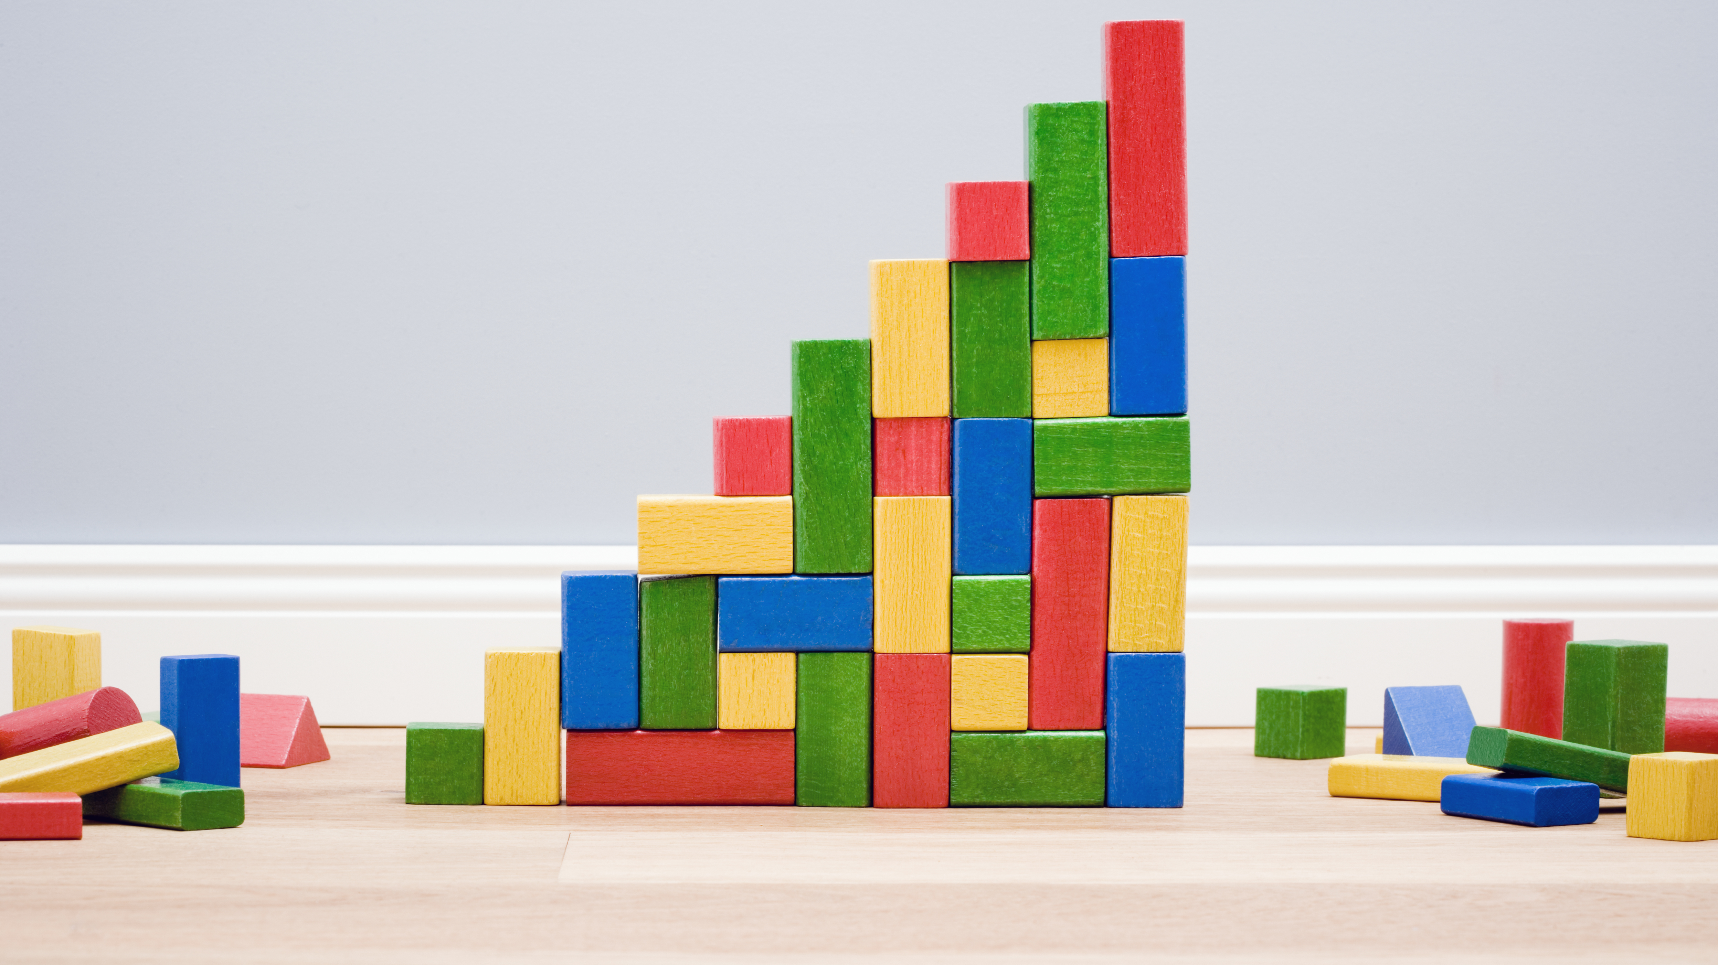
Do You think You can Build 3D shapes from a drawing?

Slide 12
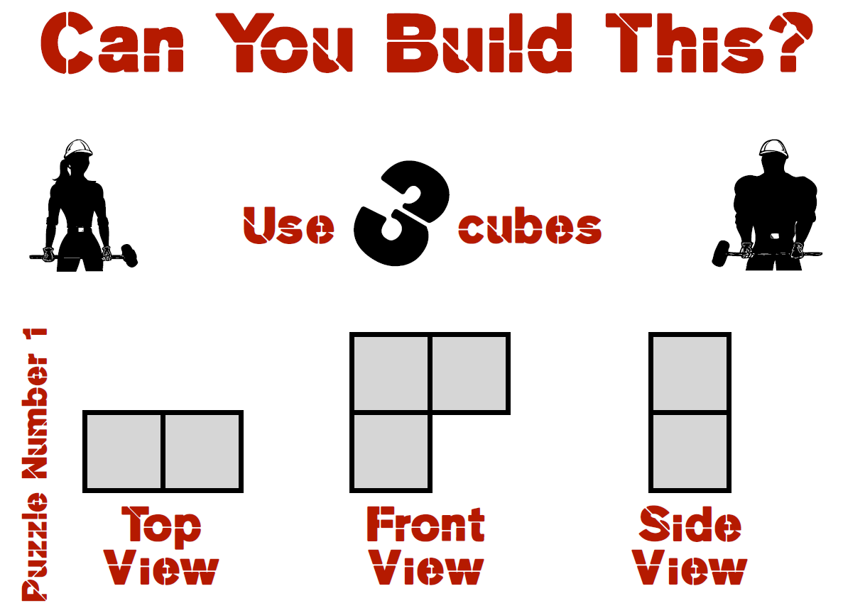

Slide 13
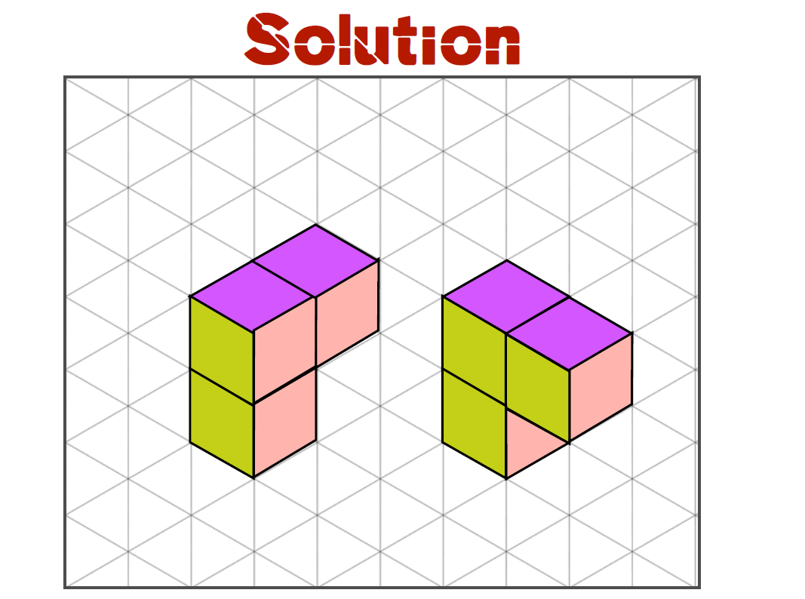

Slide 14
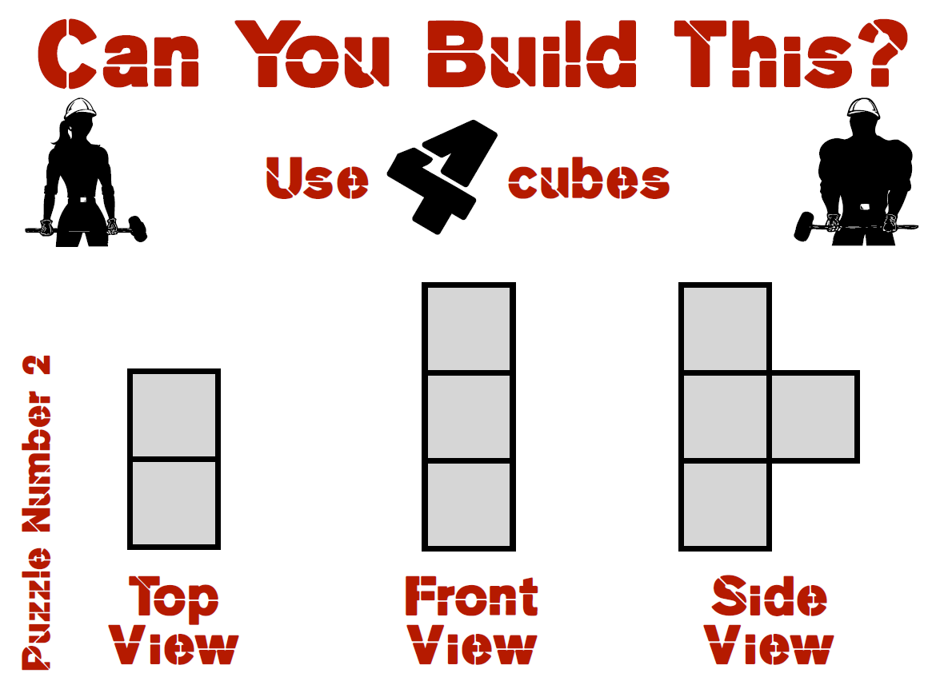

Slide 15
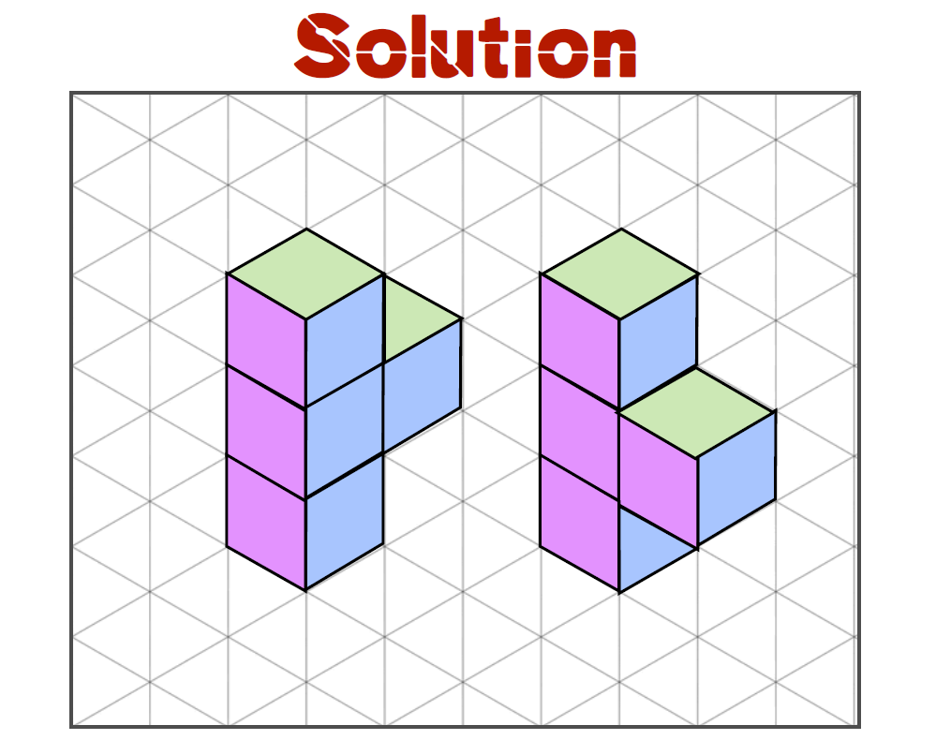

Slide 16
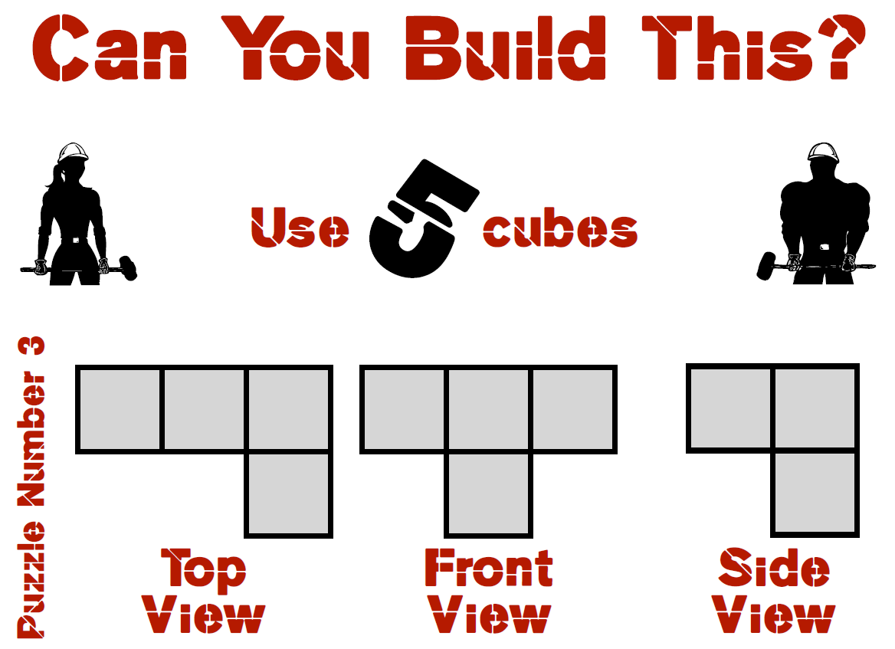

Slide 17
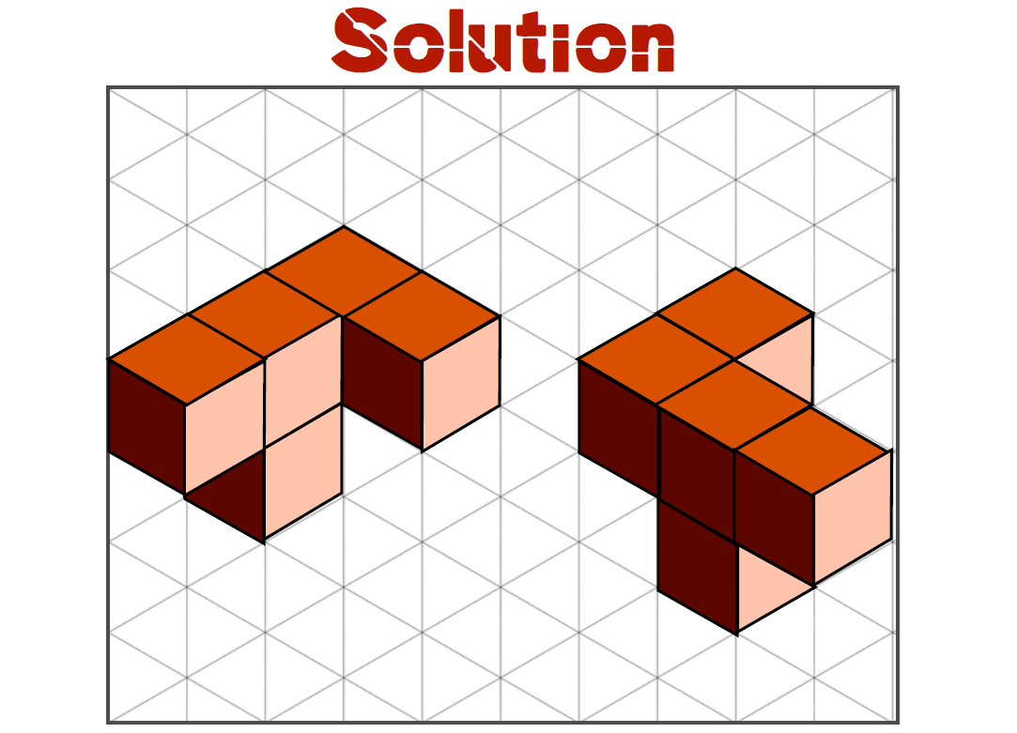

Slide 18
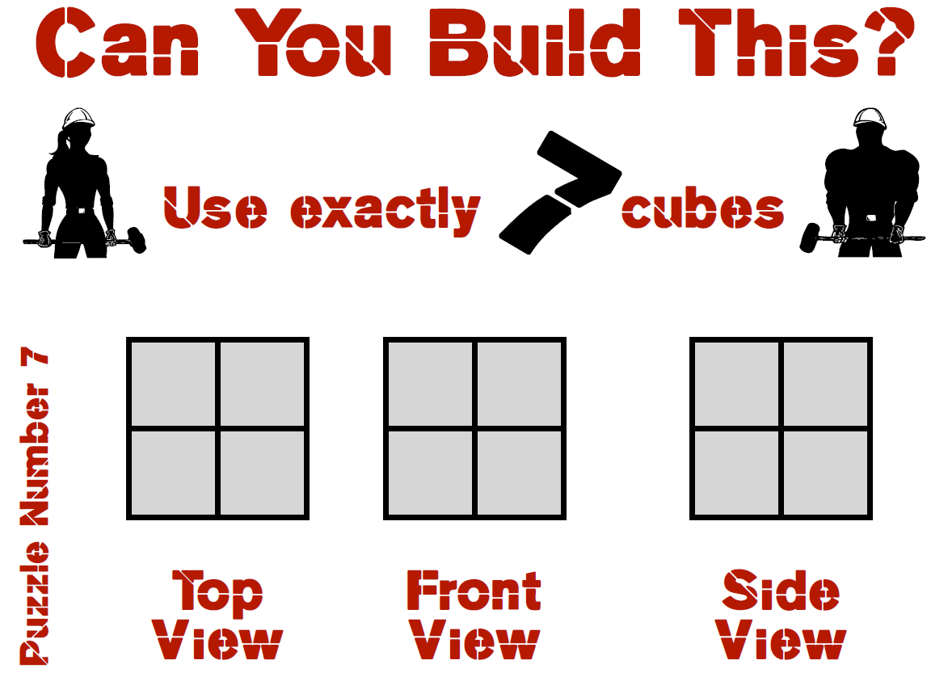

Slide 19
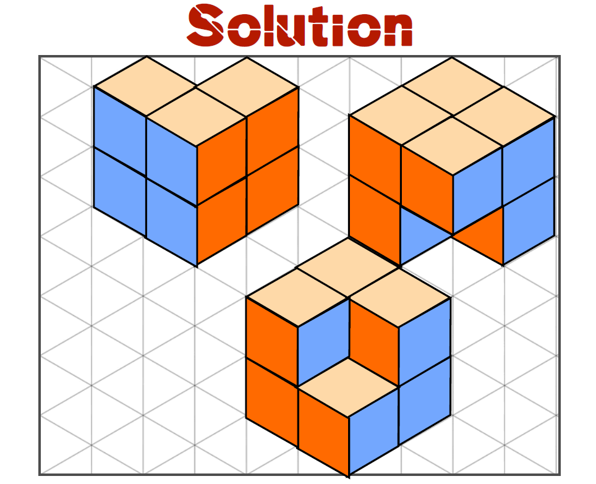

Slide 20

Do You think You can Draw the Different Views of a 3D Shape?

Slide 21
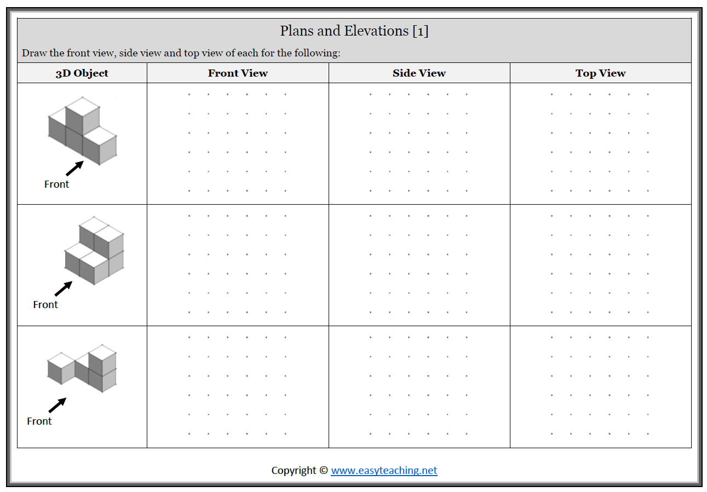

Slide 22
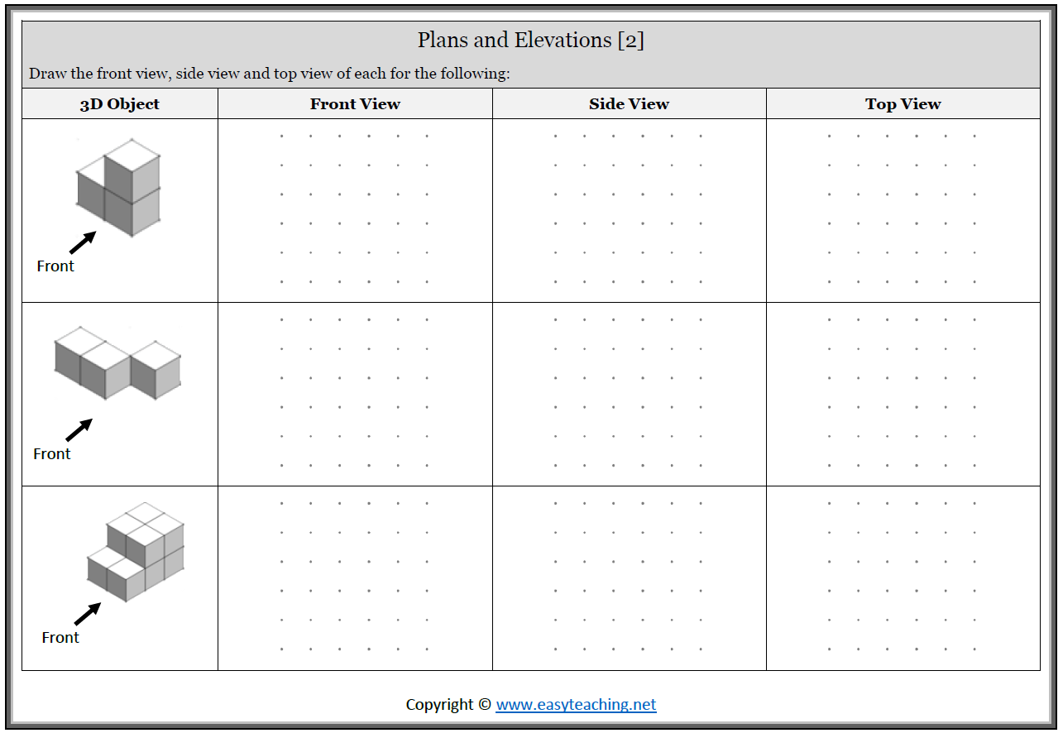

Slide 23
